Slide 1

Analysis of Water Temperature In the Bay In The Years
1989-2019
12.06.24
By: Amar Anand, Betel Mekonnen, Garret Shen, Franciszek Pajak

Slide 2
Introduction - Dataset
Our chosen dataset is called Water Quality Data for the Refuge.
Data was collected from U.S. Fish and Wildlife Service by volunteers who took samples once every two weeks of Turbidity, pH, Dissolved Oxygen, Salinity & Temperature.
Entire dataset was published on Data.gov
We chose this particular dataset since we are interested in the quality of water that are local to us.
Used Python to calculate the results
Notes:
Should we talk more about our cleaning process? Should we talk about our outliers? Software used?

Slide 3
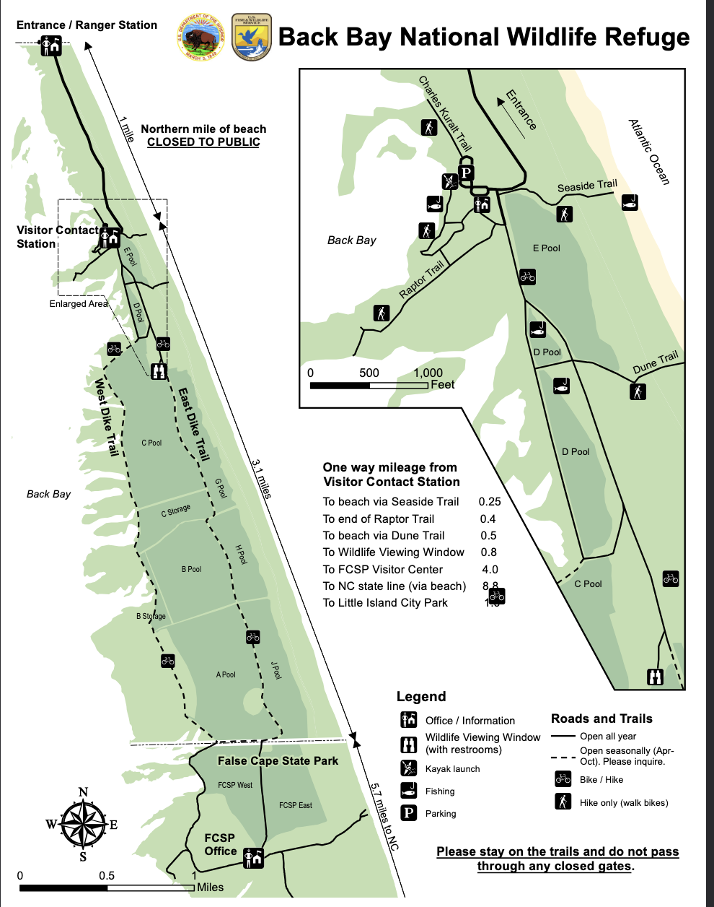
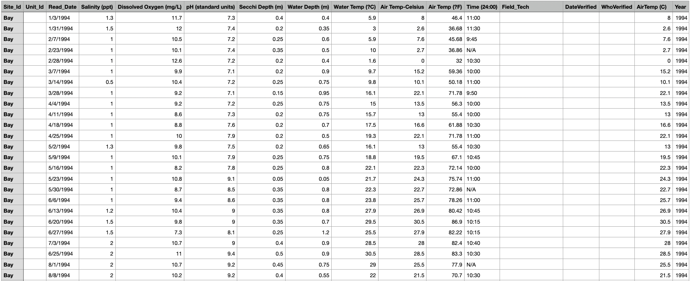
Introduction - Dataset
Dataset contains 2372 samples from various water bodies: The Bay, D-Pool (fishing pond), C-pool, B-pool and A-pool.
Notes:
Should we talk more about our cleaning process? Should we talk about our outliers? Software used?

Slide 4
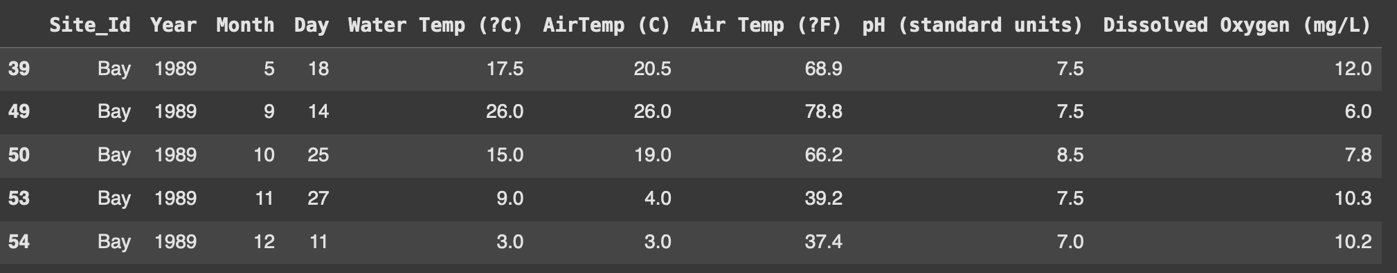
Introduction - Preprocessing
N = 514
We reduced it to 514 rows by filtering out any sample with empty data cells
Looking at the data from the months of September to May
Looking at the data from the year 1989 to 2019
We chose only to look at samples taken from the Bay
Used IQR Method to get rid of outliers
Notes:
Should we talk more about our cleaning process? Should we talk about our outliers? Software used?

Slide 5
Introduction - Research Question
Research Question:
What is the true mean of water temperature in the Bay from 1989 to 2019 in the months of September through May?
Real Life Applications:
Water temperature is significant for various areas of the marine ecosystem of the Bay.
Comprehensive analysis of water temperature in the bay can be used to understand fish spawning cycles as well as the bay’s flora and fauna.
Climate change monitoring: Historical water temperature data offers critical insights for understanding long-term climate trends and informing policies.
Notes:
Do we need to provide sources for these real life applications? Do we need to tie them into our conclusion? We want to look for optimal sample size

Slide 6
Introduction -Population Parameter
Population Unit: Bay water samples
Measured by water temperature (in C) from samples taken in the bay between September and May from 1989 to 2019.
Variable of interest is water temperature in the Bay
The value represents the water temperature of The Bay at the time of sampling
The population mean, μ, is 14.227
The size of our population, N, is 514
The optimal sample size (n) we determined to be best was 85 samples
- ɑ-level of 0.05

Slide 7
5-in-30 Systematic Sample for Ordered Population
We ordered our population with respect to our variable of interest
Then we took the first 30 observations (called primary units)
We performed a systematic sample with a total sample size of 85.
Each primary unit consists of (approximately) 17 elements. Which is the number how many times the pattern of 30 units is repeated in the population, ‘Mi’.
The two numbers to represent ‘n’ and ‘N’ were 5 and 30 respectively
○ ‘n’ represents the sample size of the primary units
○ ‘N’ represents the number of primary units in the population
Notes:
We will Split the population into thirty primary units. Five of these units will be chosen and the y-values of the secondary units within will be observed. Each primary unit consists of (approximately) 17 elements. This means that our sample size should have size n = 85 (approximately). If we want to include the whole population M = 514 units and our primary units have size 30 then to include the whole population four of our primary units will have size 31.

Slide 8
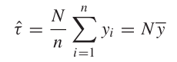
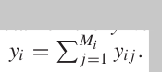
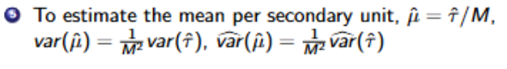
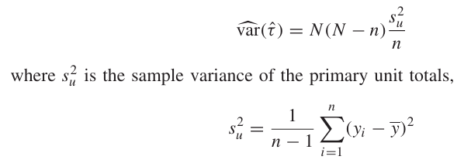
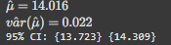
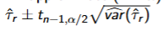
5-in-30 Systematic Sample for Ordered Population (cont.)
Formulas
Remember
Estimated Values:
Notes:
We need to add formulas for confidence interval

Slide 9
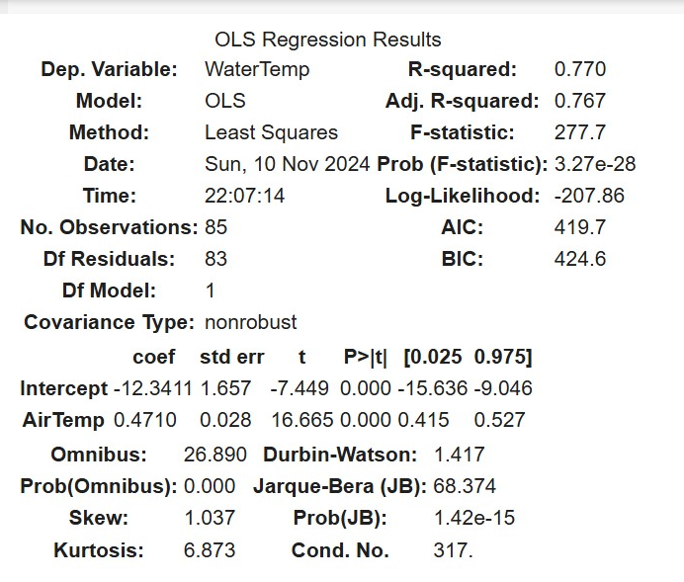
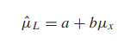
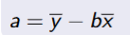
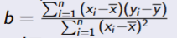
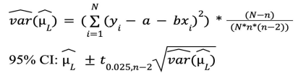
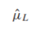
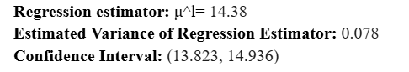
Regression Estimator w/ SRS
(Auxiliary Variable: Air temperature)
SRS: N=514, n=85
X: Air Temperature (Auxiliary Variable)
Y: Water Temperature (Variable of Interest)
Correlation: 0.901
Notes:
What is the correlation?

Slide 10
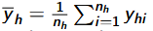
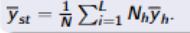
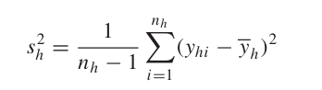
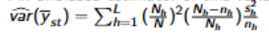
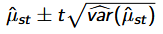
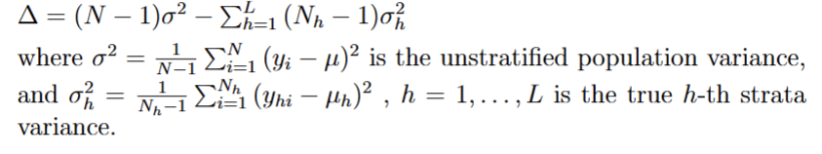
Stratification w/ Prop. Allocation
Principle of Stratification
Stratify the data to ensure that each stratum is distinct, while units within each stratum are similar
Divided the dataset into five strata using air temp
(see the below section)
Stratification boundaries based on air temperature
1: 5 strata, <40, 40-50, 50-60, 60-70, >=70
2: 4 strata, <40, 40-55, 55-70, >=70
3: 3 strata, <40, 45-65, (>=70 and 40-45)
Deltas: 1: 79405, 2: 78438, 3: 70536
Highest delta is in 1, so we used the strata there.
Delta Formula:
Notes:
How did we stratify? talk about size of stratum

Slide 11
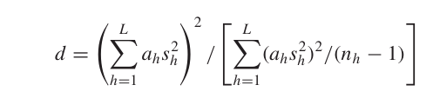
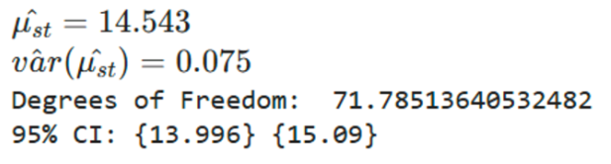
Stratification w/ Prop. Allocation
(continued)
Stratum sizes
N_{h} values for the strata we selected:
46, 120, 143, 109, 96.
Proportional Allocation
Selected sample sizes (n_{h}) proportional to the population size in each stratum:
7, 20, 24, 18, 16.
Note: n₁ rounded to 8, but then n=86 (we were looking for n=85), so we rounded n₁ down to 7.
Results:
d=
Notes:
How did we stratify? talk about size of stratum

Slide 12
Ratio Estimator w/ Double sampling
(Auxiliary variable: Air Temperature)
Auxiliary Variable: Air Temperature (in F)
High correlation to variable of interest.
Correlation: 0.901
R-squared: 0.859; Adj-R squared: 0.857
Sampling Method: Performed a double sampling with SRS
Conducted a regression analysis to validate the estimator’s suitability.
Confirmed that air temperature (x) and water temperature (y) follow a linear relationship.
Verified that when x=0, y=0
Notes:
List assumptions. Talk about linear relationship

Slide 13
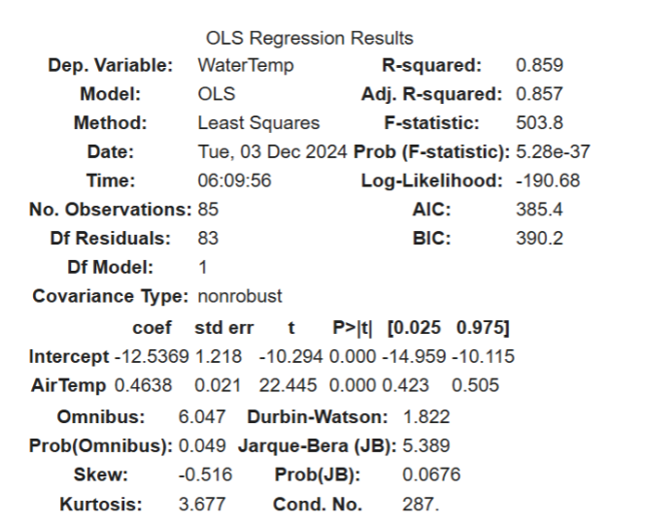
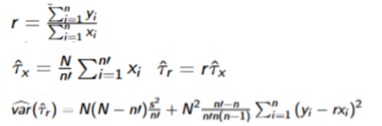
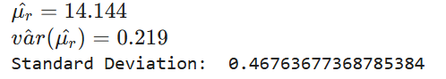
Formulas
Estimated Values:
Notes:
We need to find CI
Garret addition: The formulas listed are double sampling. Consider talking about the regular ratio estimator

Slide 14
Conclusion - Findings & Analysis
Name of Estimator | Mean | Var | SD | 95% C.I.
Systematic Sampling (5-in-30, Ordered) | 14.016 | 0.022 | 0.148 | [13.723, 14.309]
Ratio Estimator w/ double sampling SRS (Air temp) | 14.144 | 0.219 | 0.468
Regression Estimator w/ SRS (Air Temp) | 14.38 | 0.078 | 0.279 | [13.823, 14.936]
Stratified Random Sampling w/ Proportional Allocation | 14.543 | 0.075 | 0.274 | [13.996, 15.09]
Systematic Sampling (5-in-30, Ordered) was the best estimator due to it having the lowest estimated variance and the narrowest confidence interval
Both the Ratio Estimator w/ double sampling SRS and Regression Estimator w/ SRS use the auxiliary variable of Air Temperature
Stratified Random sampling uses Air Temperature to stratify the population
Notes:
Where to find estimators:
Report 8: Ratio Estimator w/ double sampling SRS (Air temp)
Report 6: Systematic Sampling (5-in-30, Ordered)
Report 5: Stratified Random Sampling w/ Proportional Allocation
Report 4: Regression estimator w/ SRS
Report 3: Hansen-Hurwitz estimator

Slide 15
Conclusion - Prospective Applications
Ecosystem
Develop strategies to protect temperature-sensitive species such as striped bass and American shad.
Fish spawning cycles are significantly influenced by water temperatures
As we saw, there is correlation between water temperature and other aspects of the ecosystem such as dissolved oxygen
Climate change mitigation
evaluate the impacts of climate change on aquatic ecosystems, identifying warming trends and planning mitigation strategies.
The bay is very shallow and while studying the average temperature we see the estimated variance of temperature is quite high

Slide 16
References
https://www.fws.gov/sites/default/files/documents/BBNWR_Visitor%20Map%28Accessibility-Checked%29.pdf
https://catalog.data.gov/dataset/water-quality-data-41c5e

